Slide 1
End-to-end AI Solution With PySpark & Real-time Data Processing With Apache NiFi
Rihab Feki, Machine Learning Engineer and Evangelist
Sherifa Fayed, Technical Expert and Evangelist
FIWARE Foundation

Slide 2
Learning goals
Managing real time data with the Context broker
Data transformation (JSON-LD to CSV) and persistence with Apache NiFi
Setting up a Google Cloud environment
Creating a Dataproc cluster and connecting it to Jupyter Notebook
Using Google Cloud Storage Service (GCS)
Modeling a ML solution based on PySpark for multi-classification
Deploying the ML model with Flask and getting predictions in real time

Slide 3
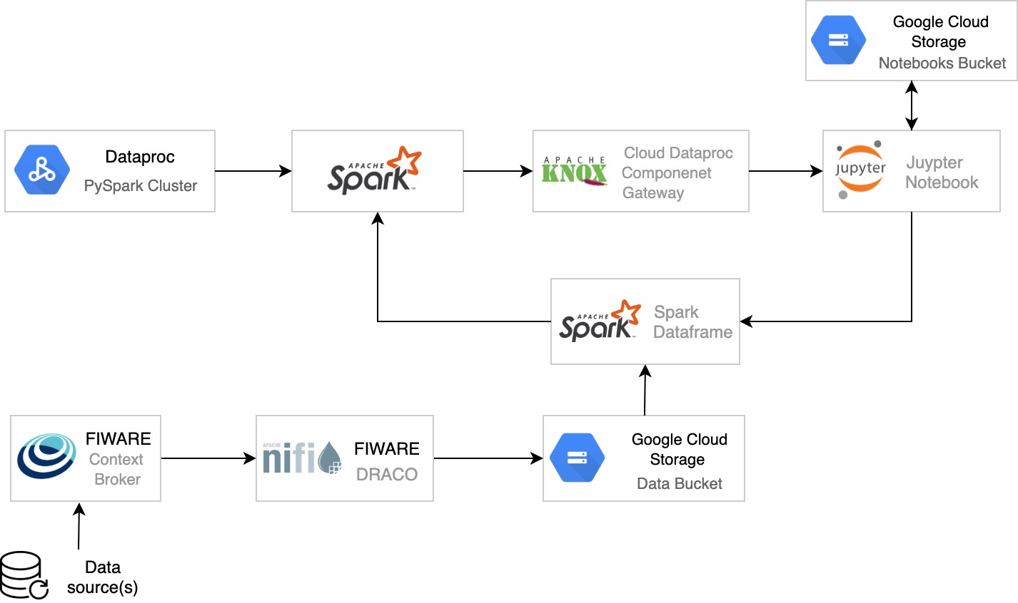

End to End AI service architecture powered by FIWARE

Slide 4
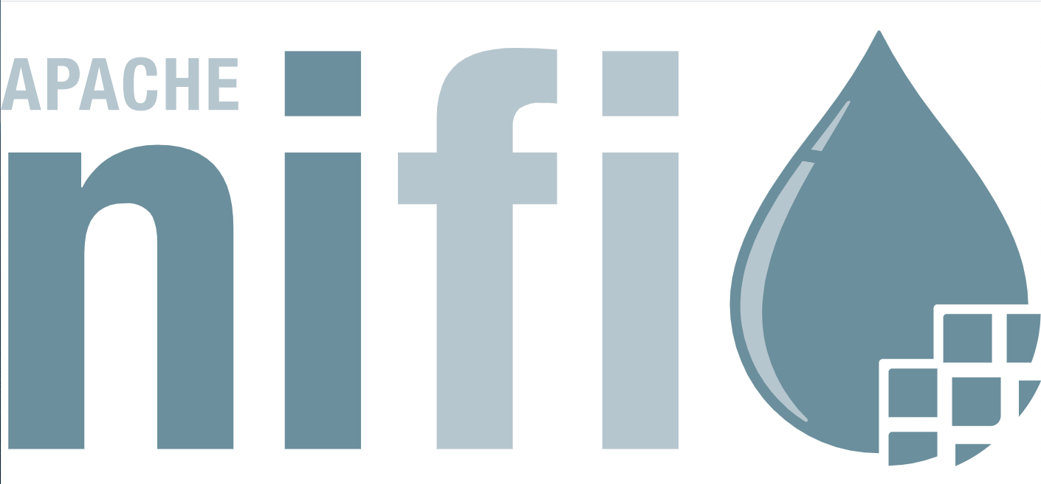
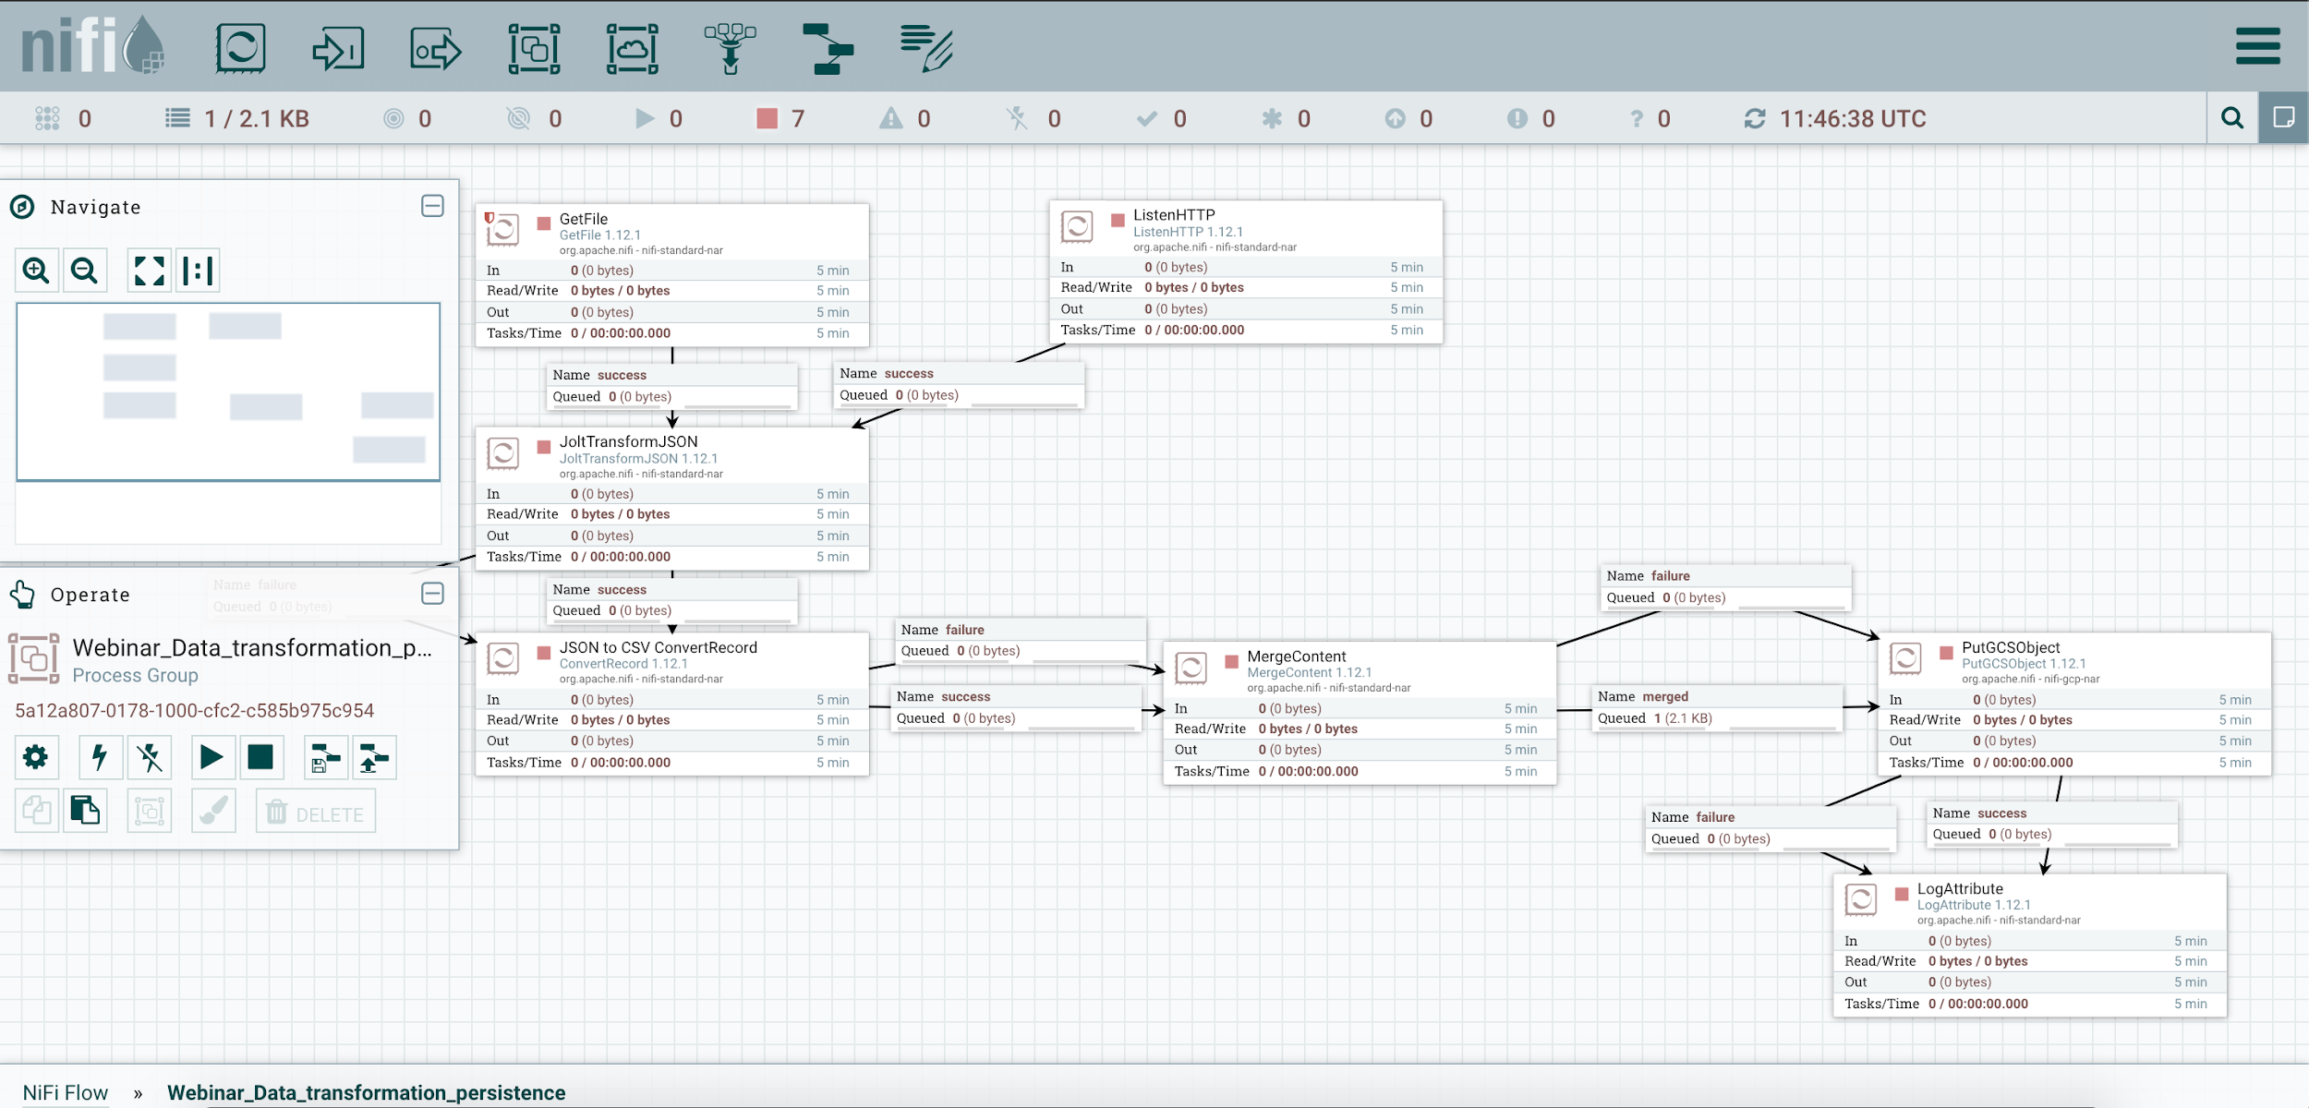
What is Apache NiFi?
System to process and distribute data
Supports powerful and scalable directed graphs of data routing and transformation
Web based user interface
Tracking data flow from beginning to end

Slide 5
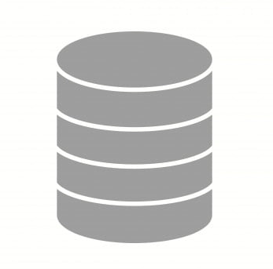
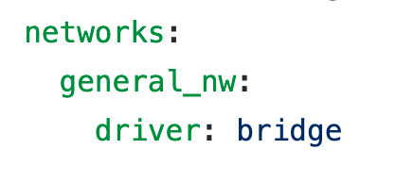
Connecting NiFi to the Context Broker
1026:1026
NGSI-LD Context Broker
5050:5050
NiFi (or Draco)
cURL or Postman
27017:27017
MongoDB

Slide 6
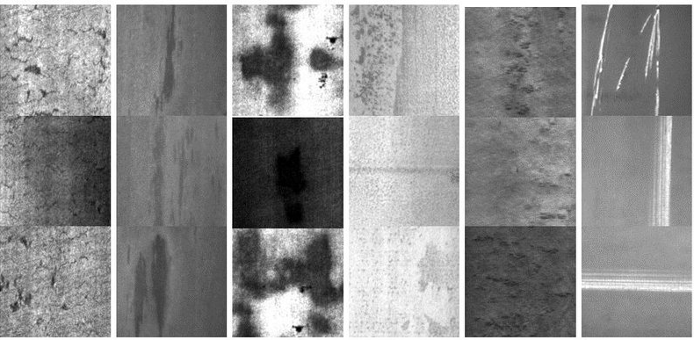
Entity: Steel plate geometric measurements
Link to dataset

Slide 7
End to End AI service architecture powered by FIWARE

Slide 8
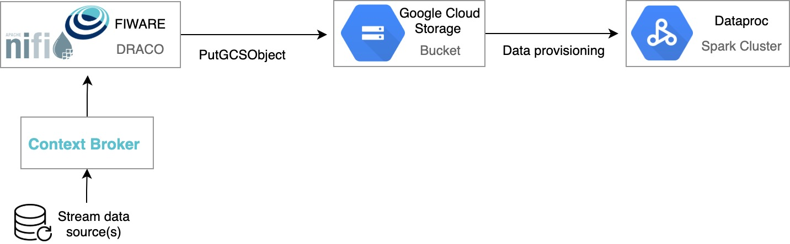
Dataflow overview
Ingesting

Slide 9
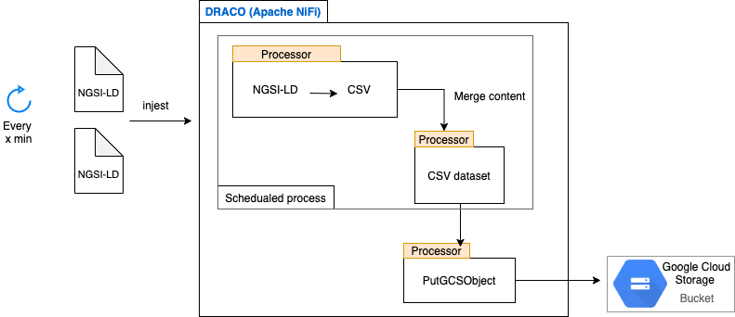
Data processing and persistence with NiFi

Slide 10
The overall NiFi workflow

Slide 11
Overview about NiFi workflow
ListenHTTP: Configured as source for receiving notifications from the Context Broker
GetFile: Reads data in JSON-LD format
JoltTransformJSON: Transforms nested JSON to a simple attribute value JSON file which will be used to form the CSV file
ConvertRecord: Converts each JSON file to a CSV file
MergeContent: Merges the resulting CSV record files to form an aggregated CSV dataset (PS: The min number of entries can be set to perform the merge processor. Also a max number of flow files can be set)
PutGCSObject: Saves the resulting CSV in Google Cloud Storage bucket

Slide 12
Demo: Data transformation and persistence

Slide 13
End to End AI service architecture powered by FIWARE

Slide 14
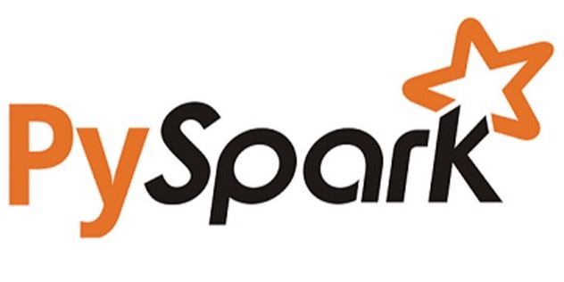
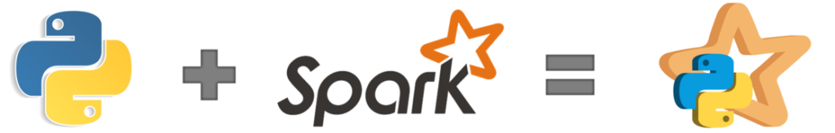
What is PySpark?
PySpark is an interface for Apache Spark in Python.
PySpark is a language for performing exploratory data analysis at scale, building machine learning pipelines, and creating ETLs for a data platform.

Slide 15
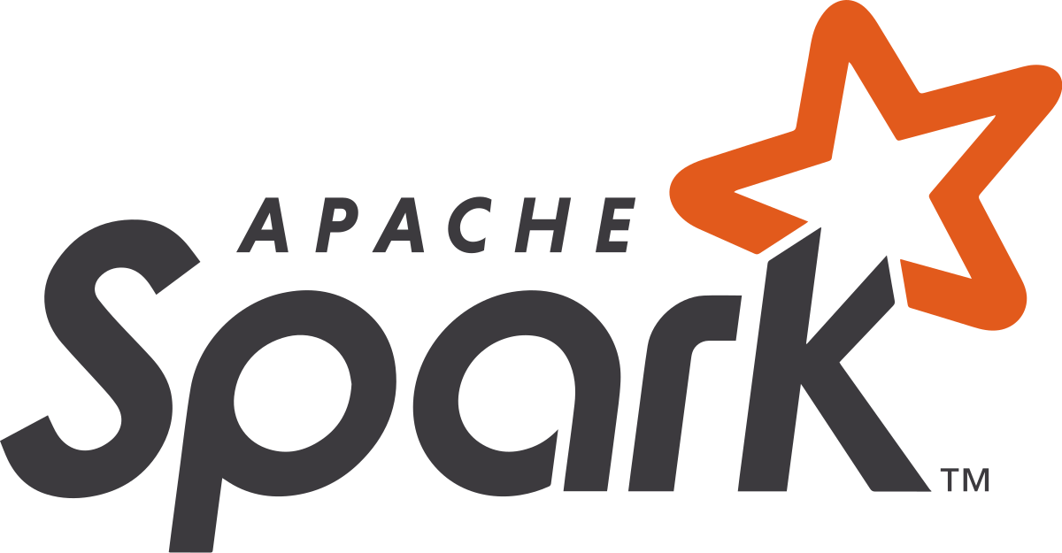

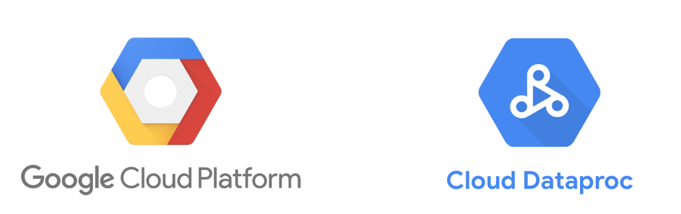
What is Cloud Dataproc?
Dataproc is a managed Spark and Hadoop service that lets you take advantage of open source data tools.
Batch processing, querying, streaming
Big data processing
Machine Learning

Slide 16
The main benefits of Dataproc
It’s a managed service: No need for a system administrator to set it up.
It’s fast: Cluster creation in about 90 seconds.
It’s cheaper than building your own cluster: Because you can spin up a Dataproc cluster when you need to run a job and shut it down afterward, so you only pay when jobs are running.
It’s integrated with other Google Cloud services: Including Cloud Storage, BigQuery, and Cloud Bigtable, so it’s easy to get data into and out of it.

Slide 17
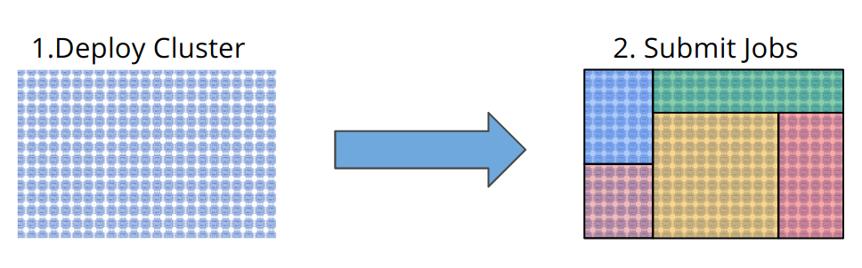
What makes Dataproc special?
Typical mode of operation of Hadoop/Spark on premise or in cloud require
you deploy a cluster, and then you proceed to fill up said cluster with jobs

Slide 18
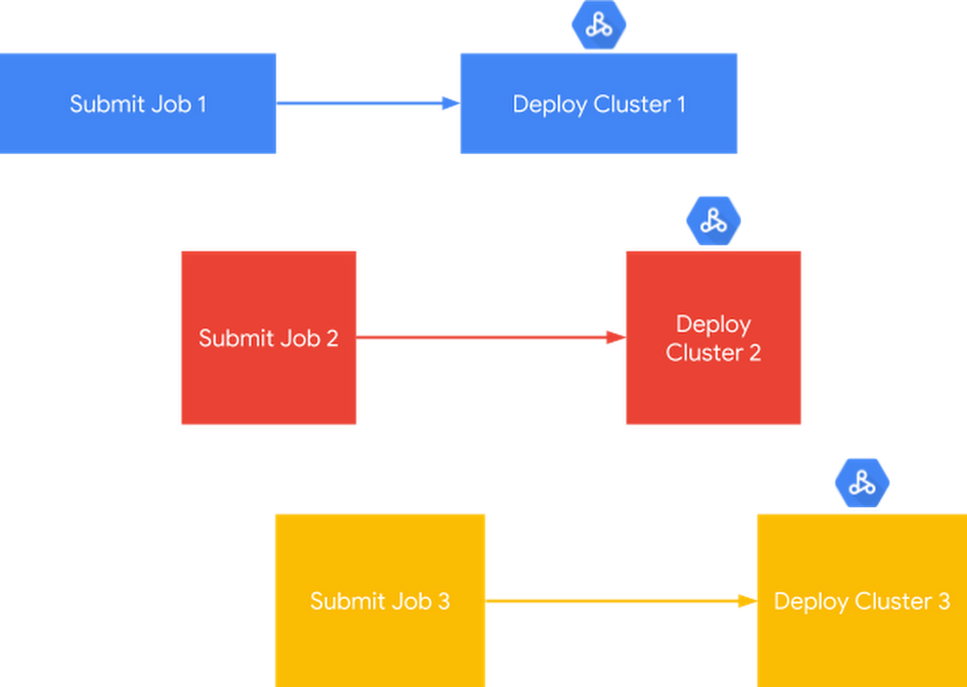
What makes Dataproc special?
Rather than submitting the job to an already-deployed cluster, you submit the job to Dataproc, which creates a cluster on your behalf on-demand.
A cluster is now a means to an end for job execution.

Slide 19
Let’s see how Dataproc makes it easy and scalable...
Data scientists are big fans of Jupyter Notebooks
However, getting an Apache Spark cluster set-up with Jupyter Notebooks can be complicated

Slide 20
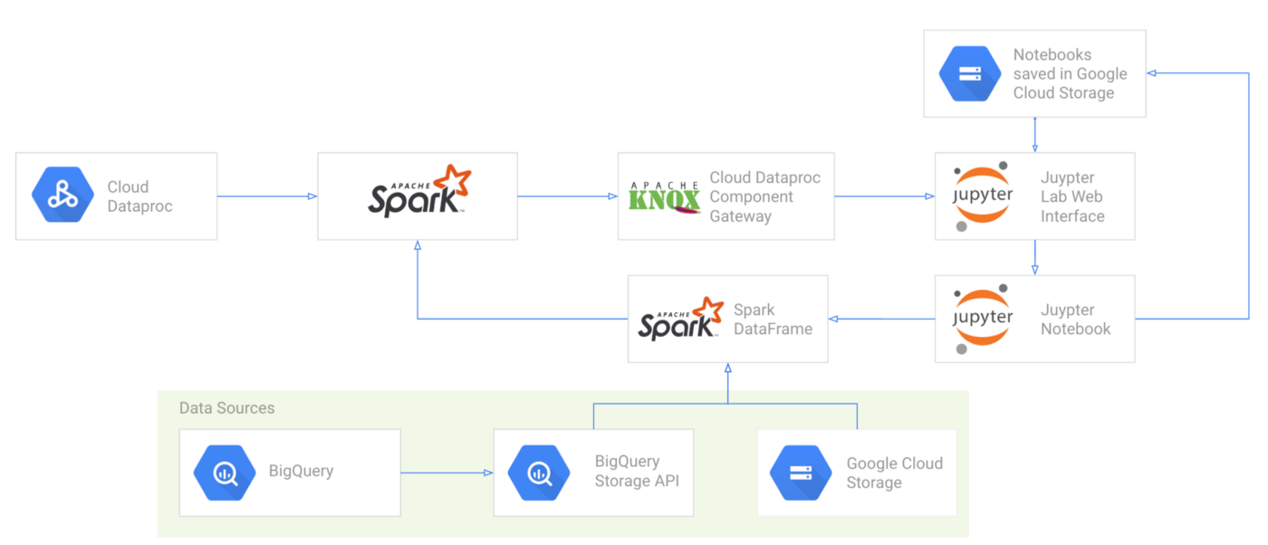
Apache Spark and Jupyter Lab architecture on Google Cloud

Slide 21
How it works ?
Setting up the Google cloud environment and creating a project
Creating a Google Cloud Storage bucket for your cluster
Creating a Dataproc Cluster with Jupyter and Component Gateway
Accessing the JupyterLab web UI on Dataproc
Creating a Notebook and developing the AI algorithm with PySpark

Slide 22
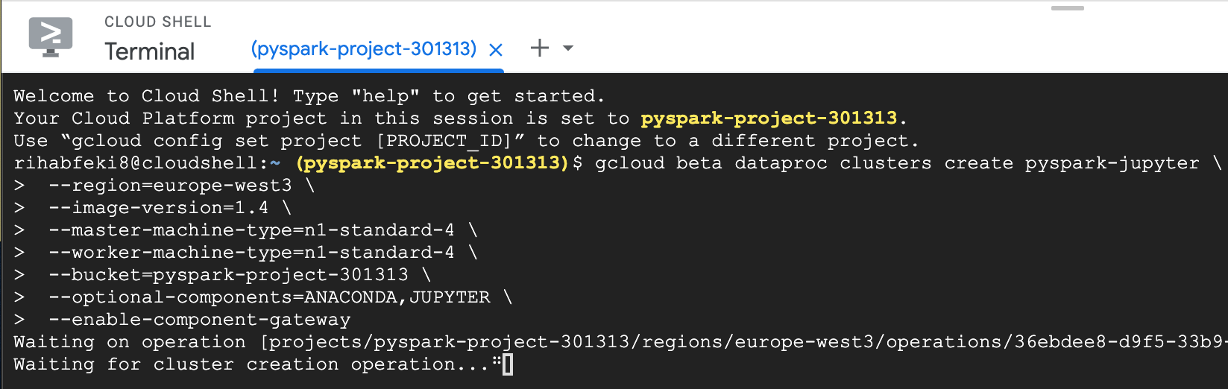
Creating a Dataproc cluster using cloud shell
gcloud beta dataproc clusters create ${CLUSTER_NAME} \
--region=${REGION} \
--image-version=1.4 \
--master-machine-type=n1-standard-4 \
--worker-machine-type=n1-standard-4 \
--bucket=${BUCKET_NAME} \
--optional-components=ANACONDA,JUPYTER \
--enable-component-gateway

Slide 23
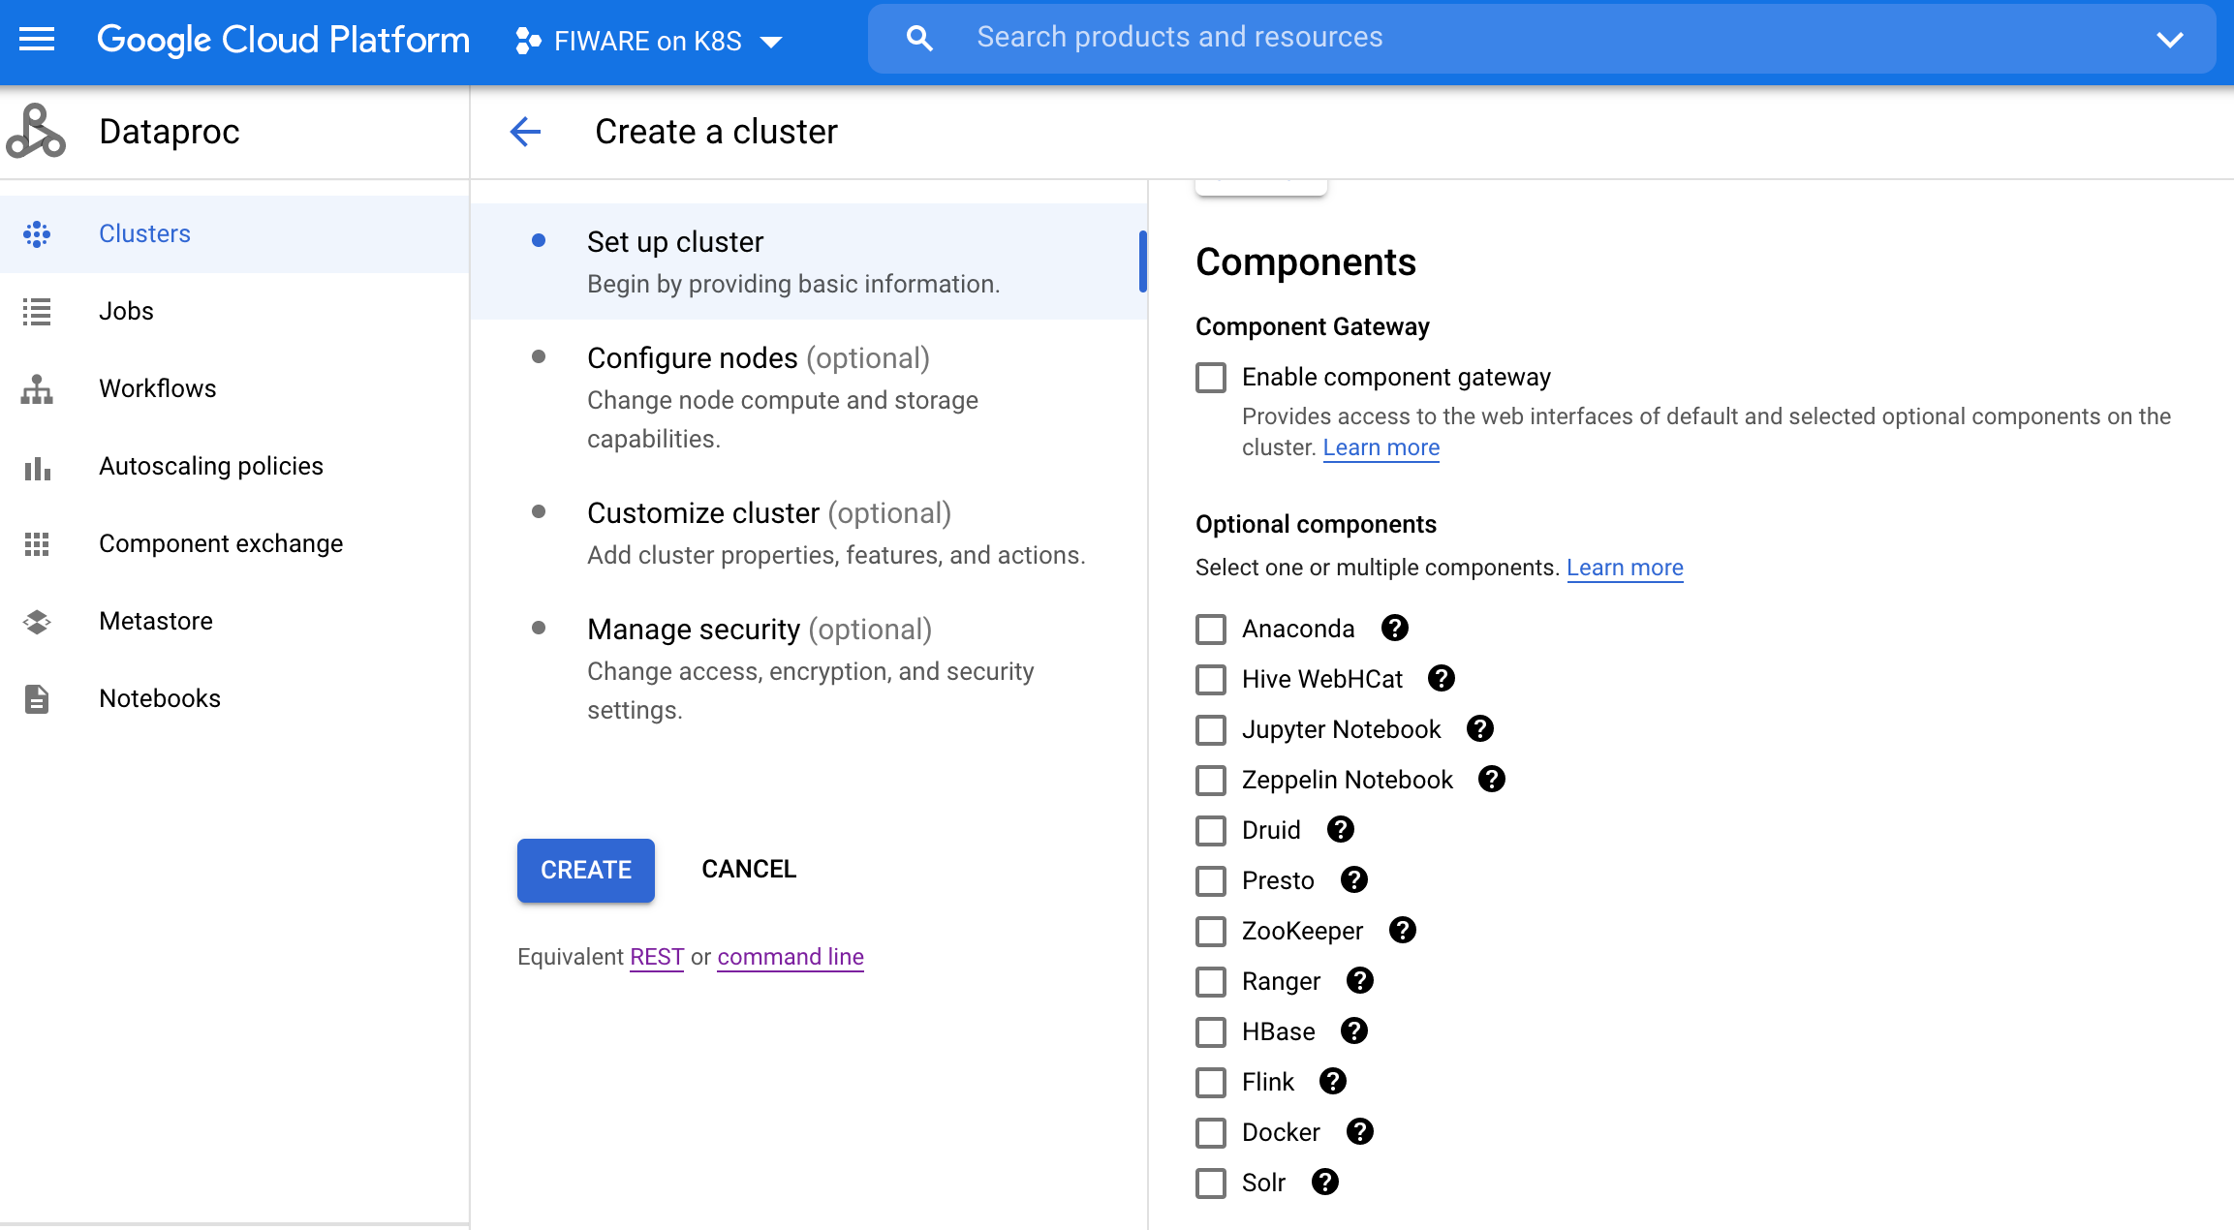
Component gateway for additional cluster components

Slide 24
Steel plates faults prediction
Features: 27
Geometric Measurements
of the steel plates
Fault types: 7
Pastry
Z_Scratch
K_Scatch
Stains
Dirtiness
Bumps
Other_Faults
Dataset format: CSV | Number of Samples: 1941
Link to dataset

Slide 25
Demo:
Cloud environment set up
Modeling the ML solution based on PySpark

Slide 26

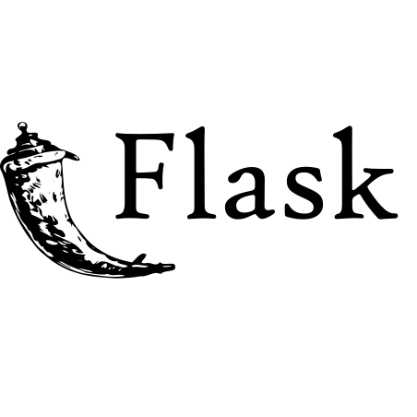
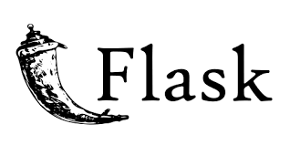

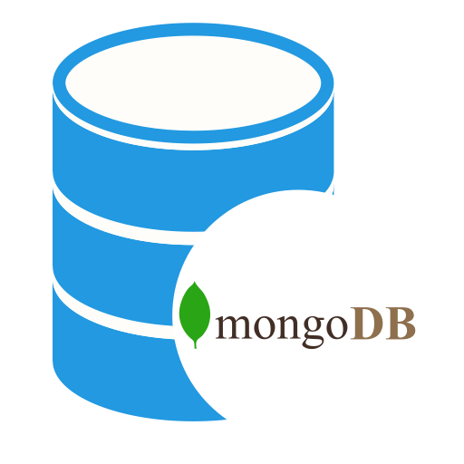
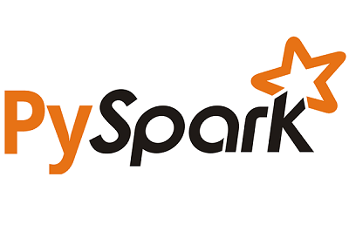
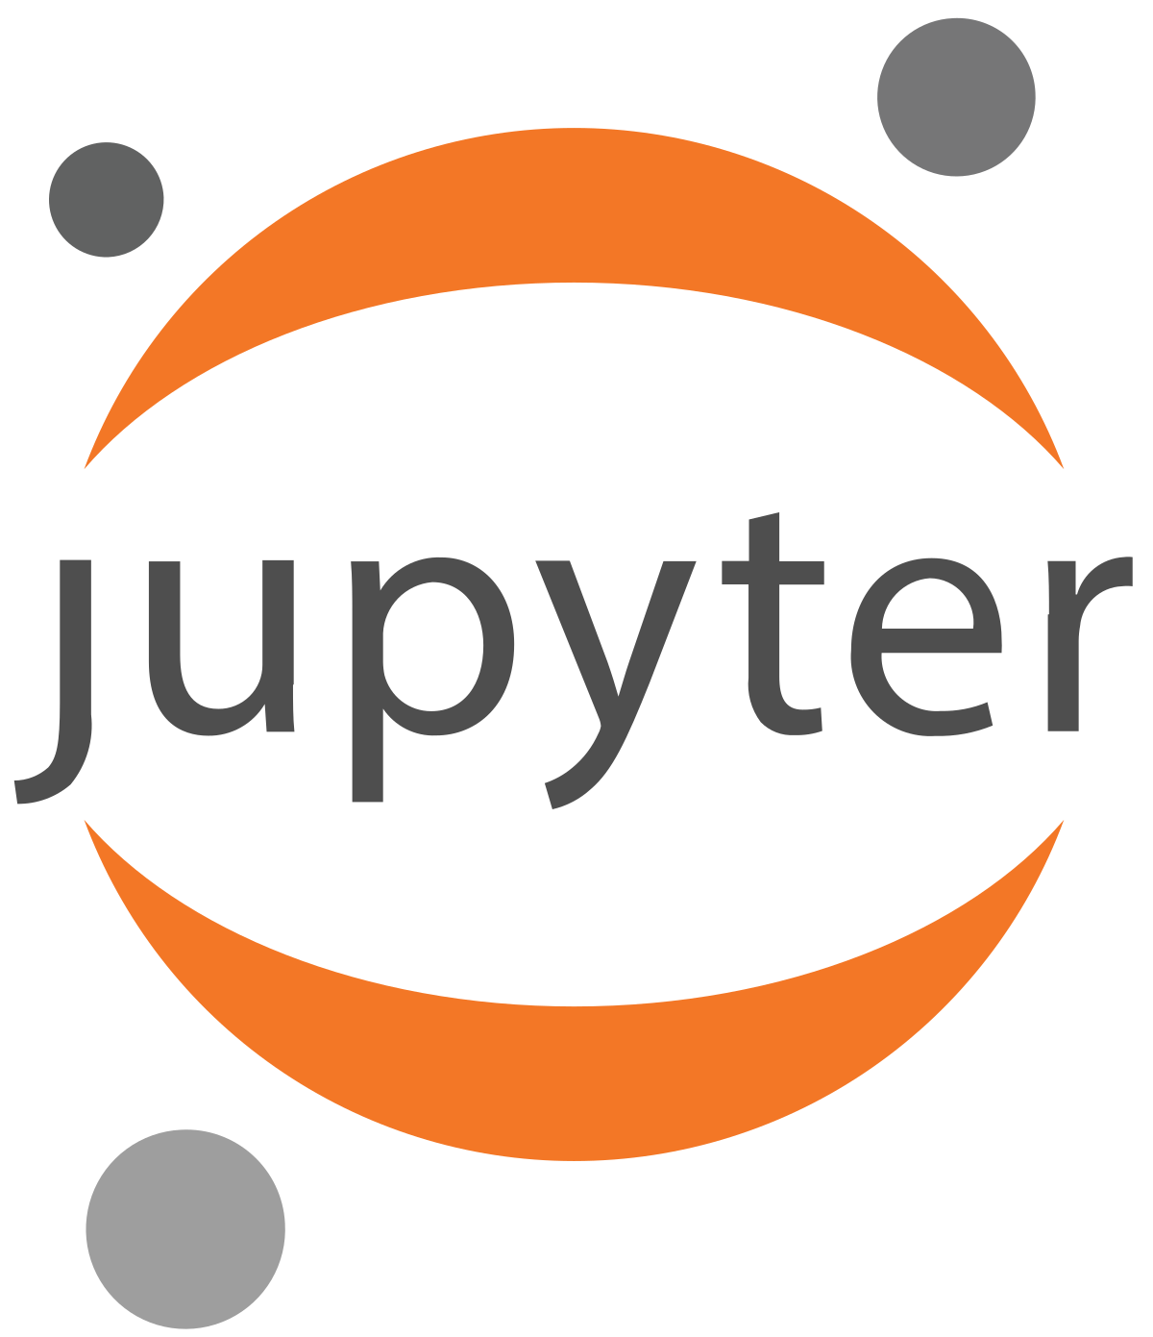
ML model deployment with Flask architecture
Jupyter Notebook
Saved Model
(.parquet)
Model prediction
www
Orion
Context
Broker
cURL or Postman
5000:5000
1026:1026
27017:27017
Model training

Slide 27
Useful links
Source code and documentation
https://github.com/RihabFekii/PySpark-AI-service_Data-processing-NiFi
Jupyter Notebook for Steel faults classification based on PySpark
https://github.com/RihabFekii/PySpark-AI-service_Data-processing-NiFi/blob/master/PySpark/PySpark_Steel_faults_Classification.ipynb
Data processing and persistence with Apache NiFi documentation
https://github.com/RihabFekii/PySpark-AI-service_Data-processing-NiFi/tree/master/Nifi
NGSI-LD Context Broker
Docker hub: https://hub.docker.com/r/fiware/orion-ld
Documentation: https://github.com/FIWARE/context.Orion-LD
Google Cloud Console: https://console.cloud.google.com/
Flask Apps with Docker: https://runnable.com/docker/python/docker-compose-with-flask-apps

Slide 28
Summary
Context Broker does not store data or persist it
Google Cloud Dataproc service provides data scientists an easy way to set up, control and secure data science environments. Plus making it simple and fast for them to integrate it with other open source data tools.
Once the Dataproc cluster is created, it is not possible to change the configuration or install new dependencies, libraries,..
Dataproc jobs are limited to some programming languages.
Apache NiFi might not be the easiest tool for data processing but it manages data flows and automates them and it fits when dealing with large scale data or real-time data.
Other cloud platforms could be used (AWS, Azure, Databricks,..)

Slide 30
Q&A

Slide 31
Annex

Slide 32
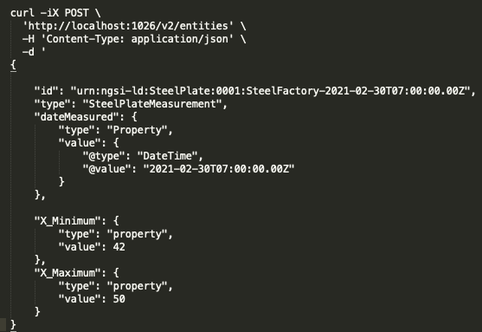
Creating an entity in the Context Broker
unique id and type
Attributes of the created entity

Slide 33
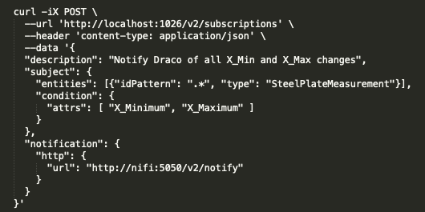
Subscribing to changes and listening
posting subscription to Orion
subscribing to all entities of certain type
subscribing to relevant attributes
sending notification to port NiFi is listening on

Slide 34
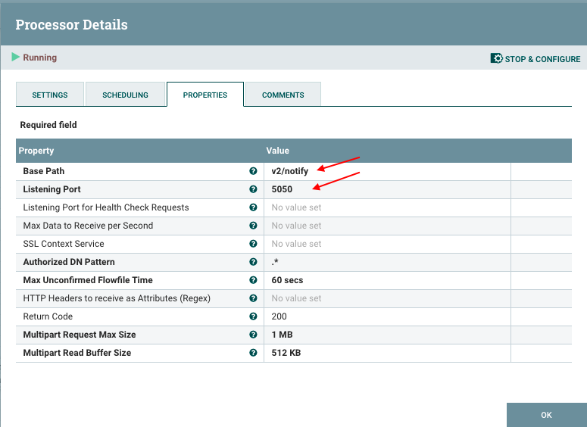
Subscribing to changes and listening

Slide 35
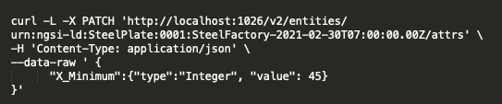
Inducing a change and receiving a notification

Slide 36
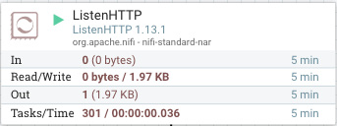
Inducing a change and receiving a notification
changing the value of X_Minimum
Processor Out Count jumps to 1

Slide 37
Setting up the cloud environment

Slide 38
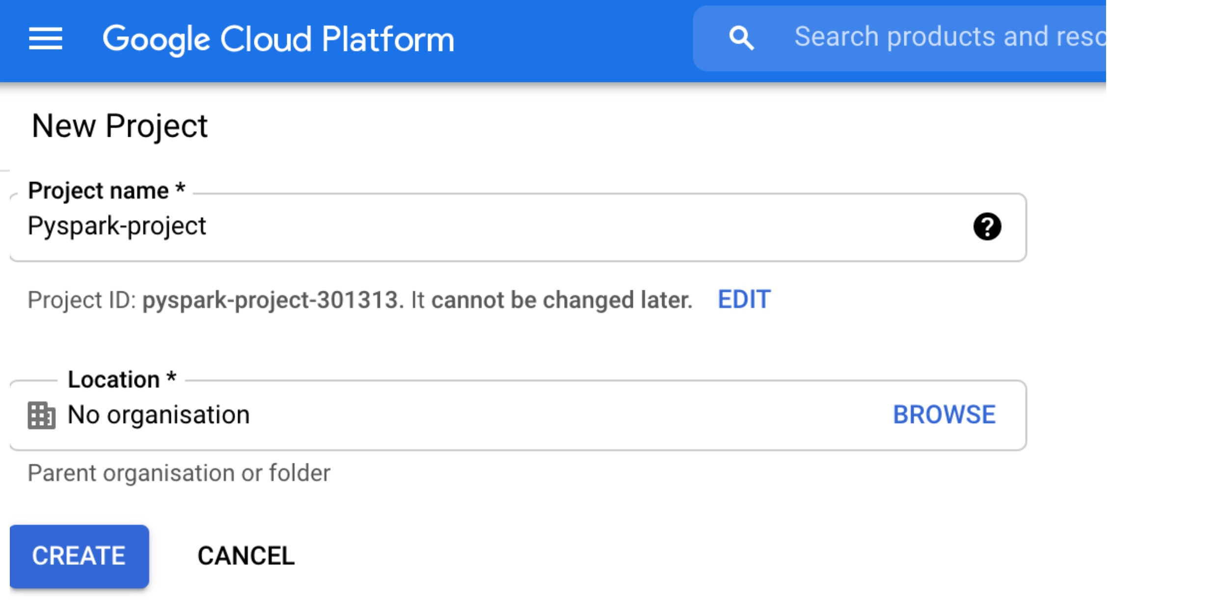

Creating a project in Google Cloud Platform
We can manage the project via the Cloud Shell

Slide 39
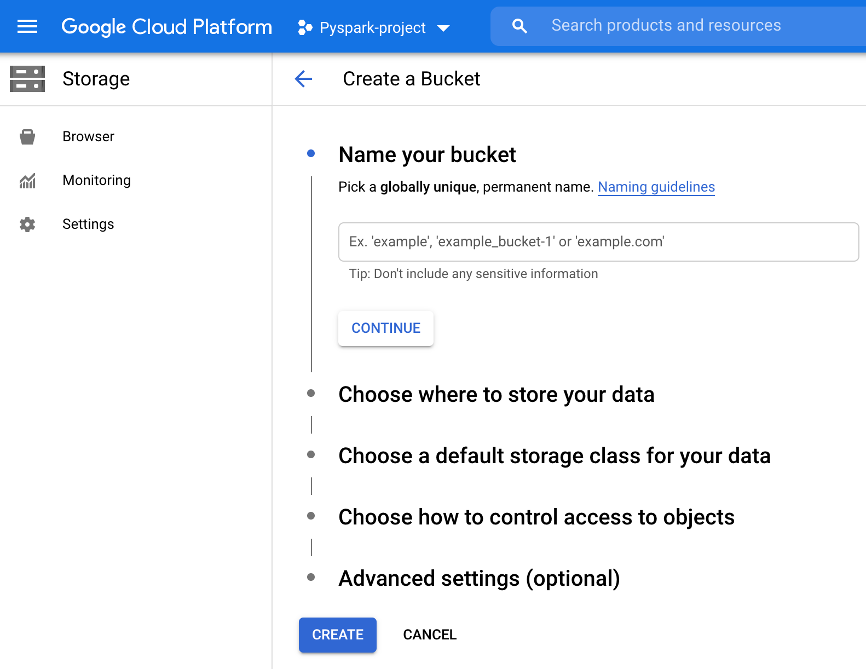
Creating a Google Cloud Storage bucket
Store datastes
Store Notebooks
Store logs
Store output files

Slide 40
Creating a Dataproc cluster using cloud shell
gcloud beta dataproc clusters create ${CLUSTER_NAME} \
--region=${REGION} \
--image-version=1.4 \
--master-machine-type=n1-standard-4 \
--worker-machine-type=n1-standard-4 \
--bucket=${BUCKET_NAME} \
--optional-components=ANACONDA,JUPYTER \
--enable-component-gateway

Slide 41
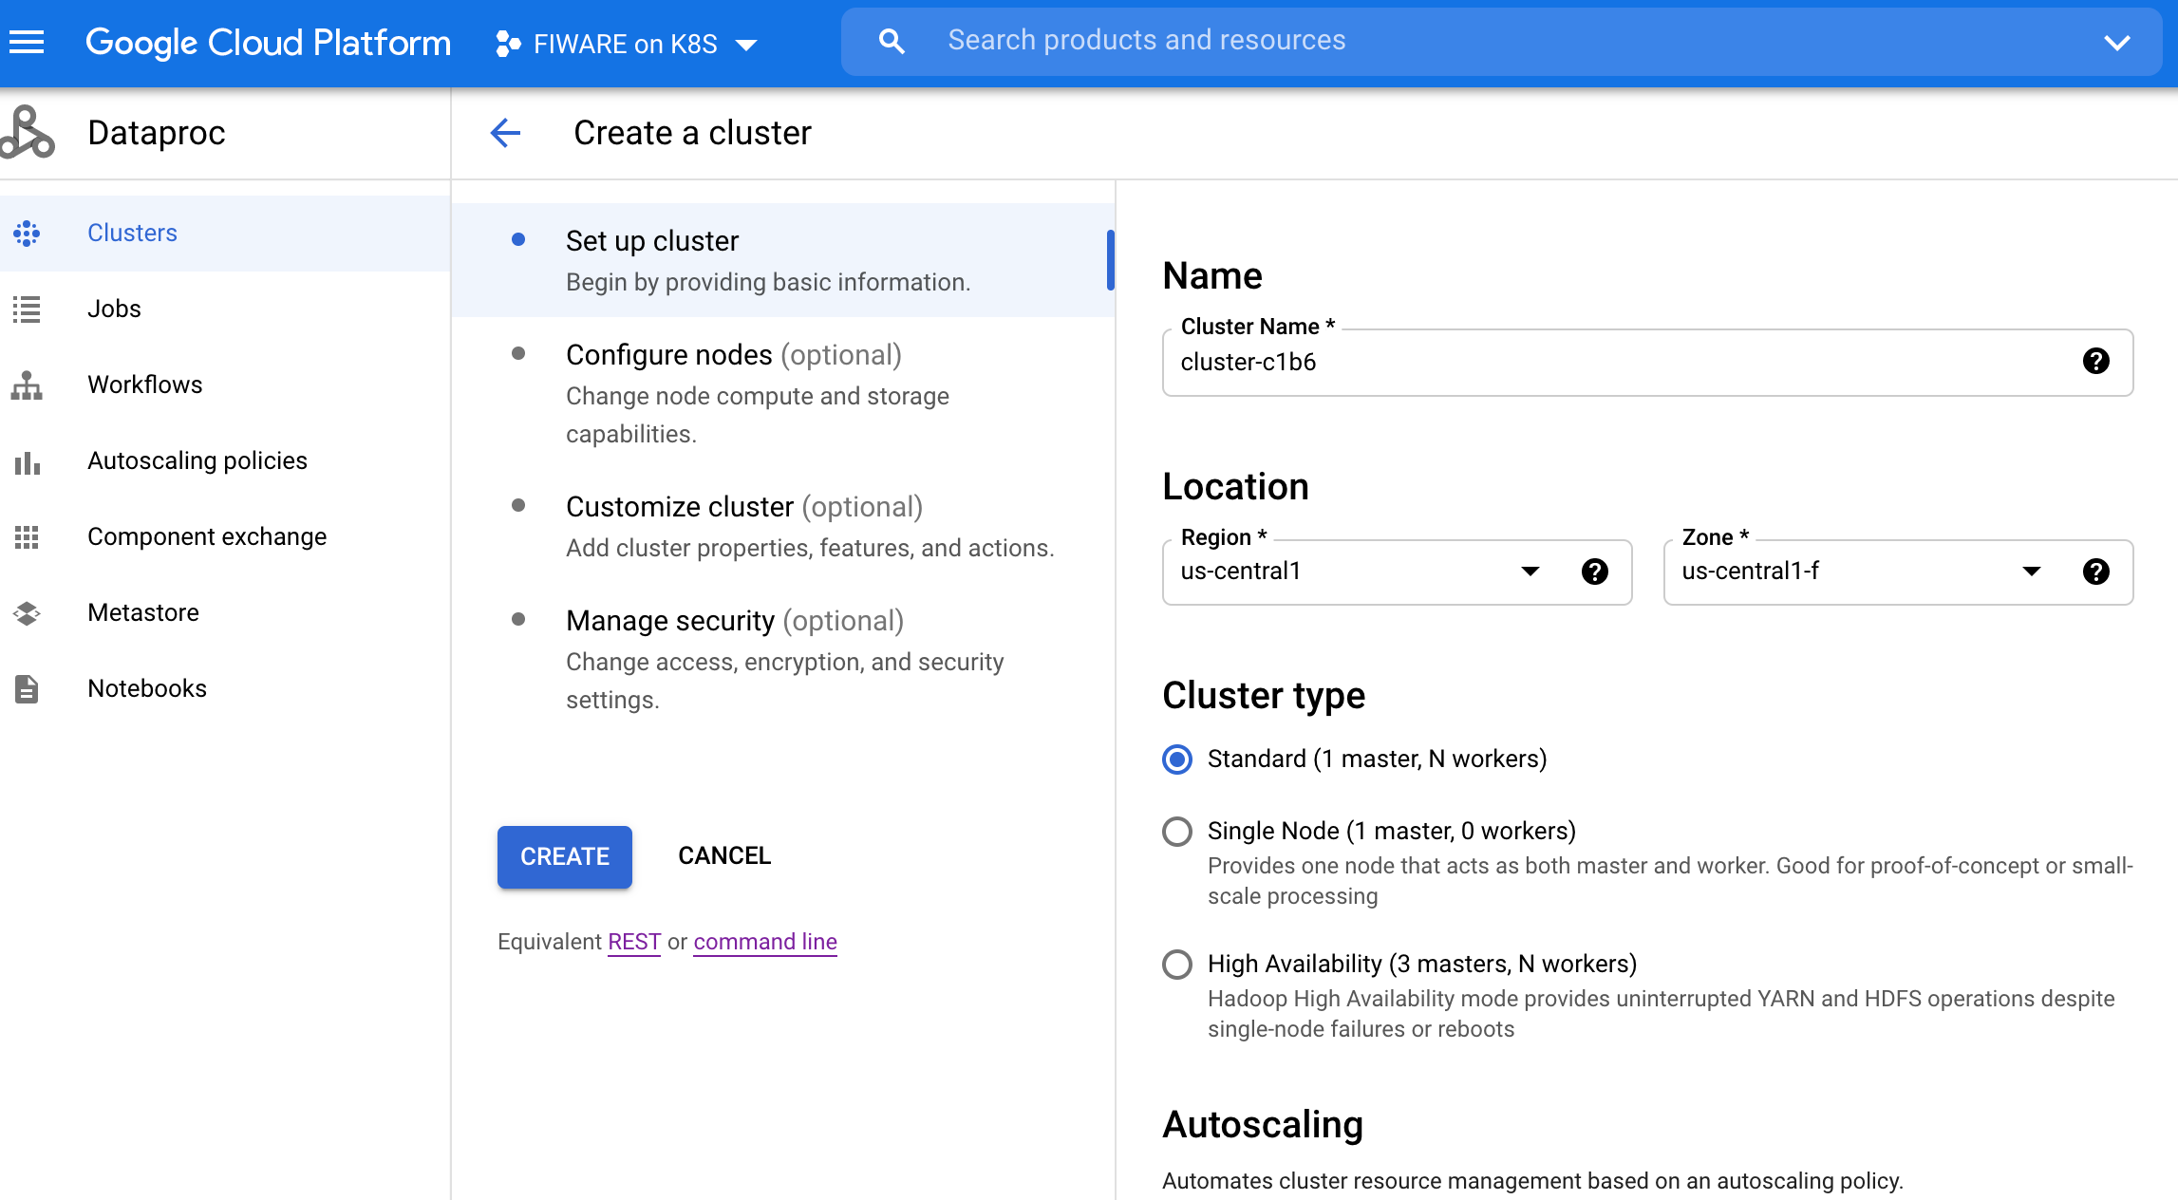
Creating a Dataproc cluster using GUI

Slide 42
Component gateway for additional cluster components

Slide 43
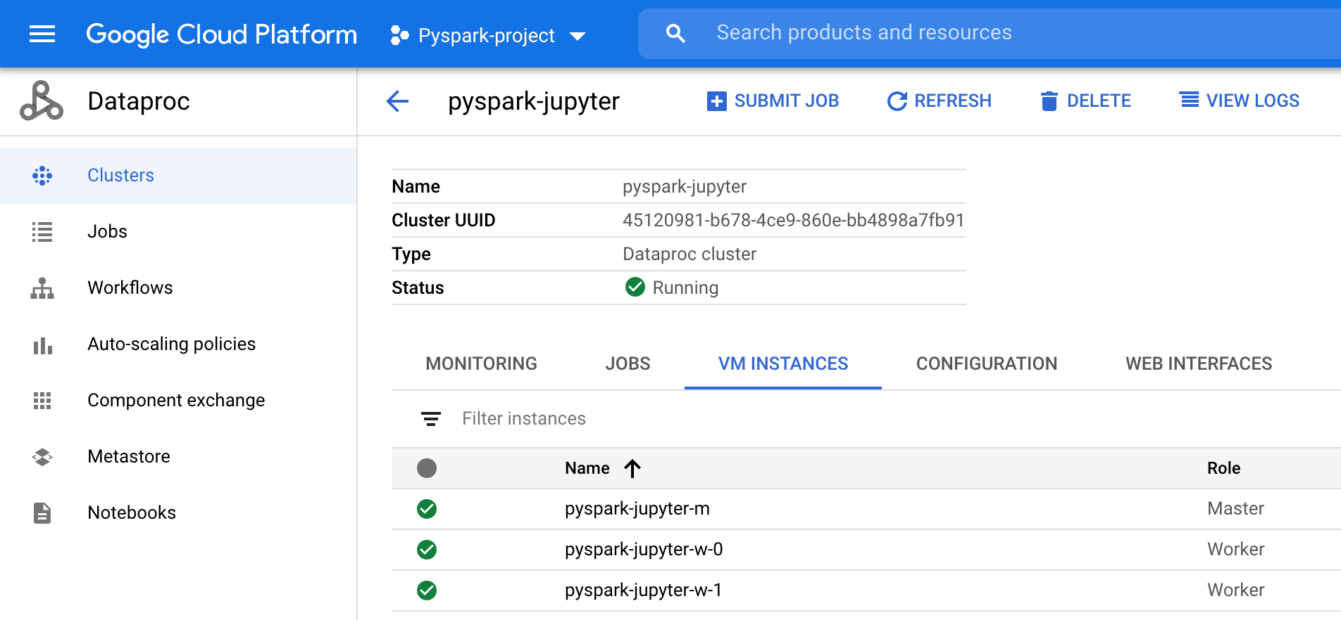
Overview of the Dataproc cluster

Slide 44
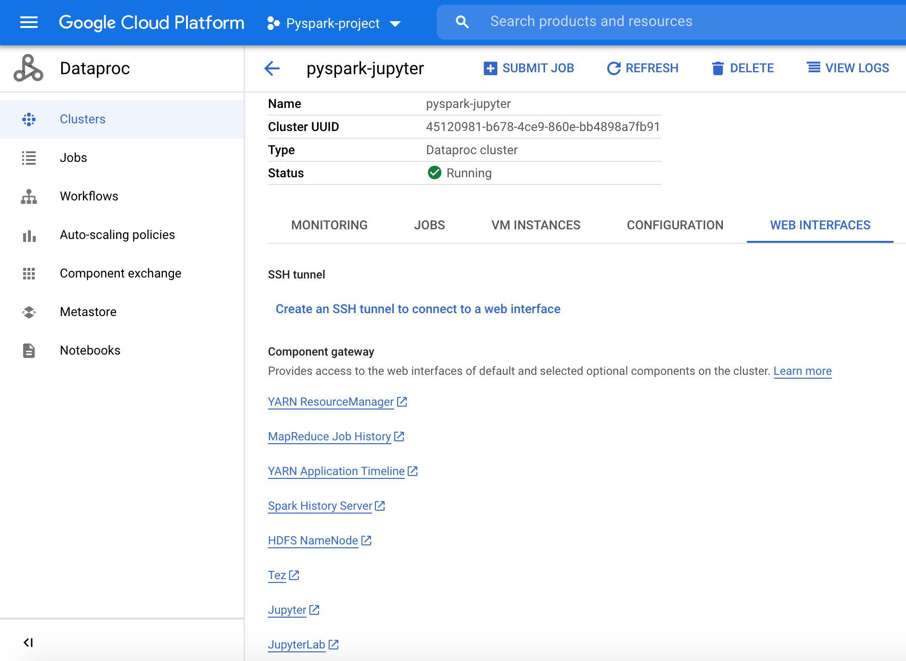
Dataproc cluster web interfaces

Slide 45
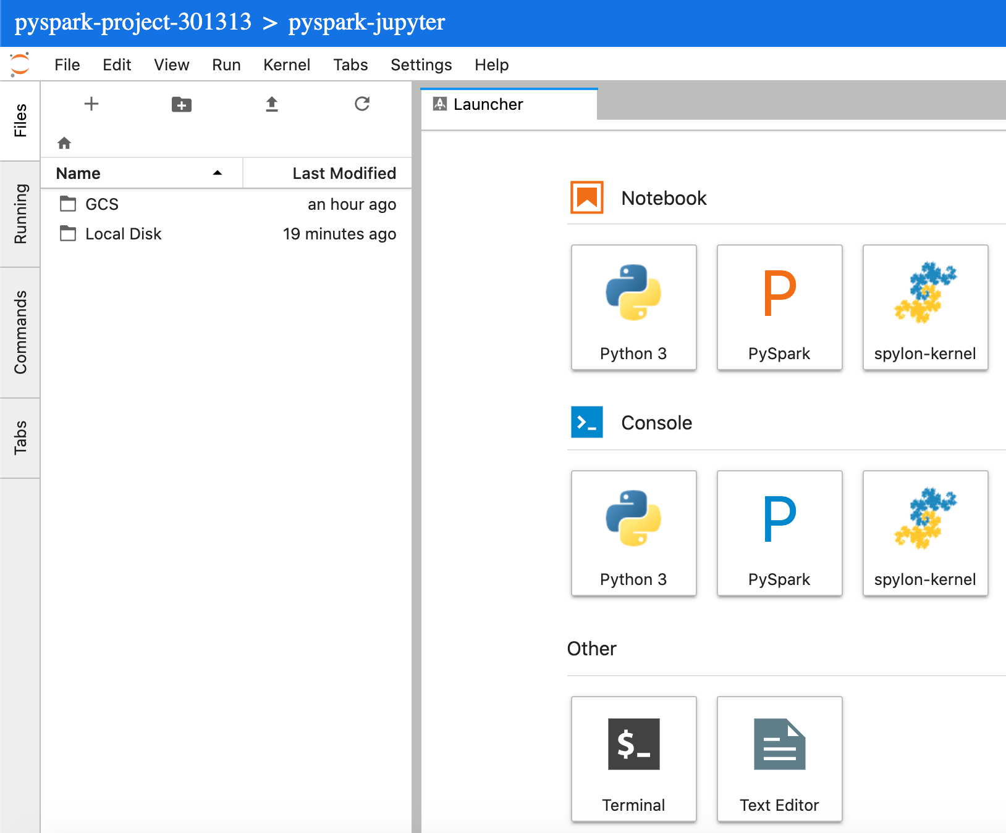
Dataproc cluster : Jupyter lab interface

Slide 46
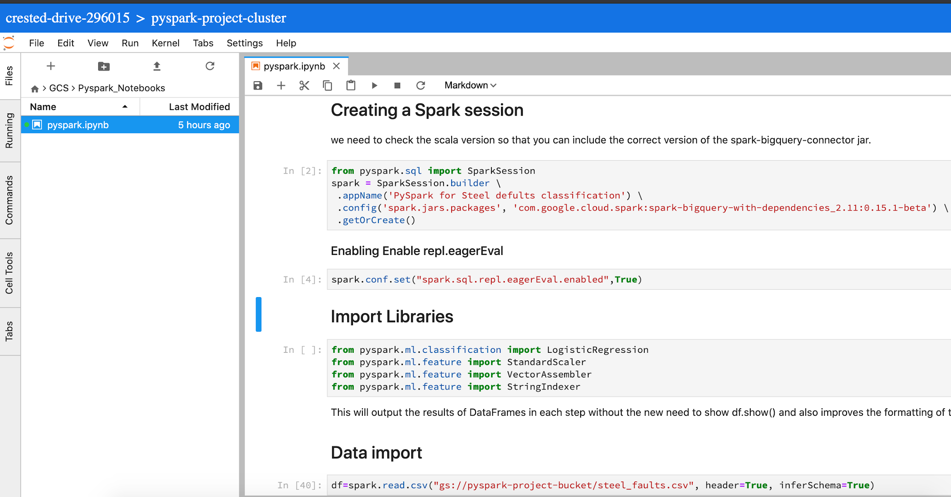
Creating a Jupyter Notebook and provisioning data from Google Cloud Bucket
Link to Notebook

Slide 47
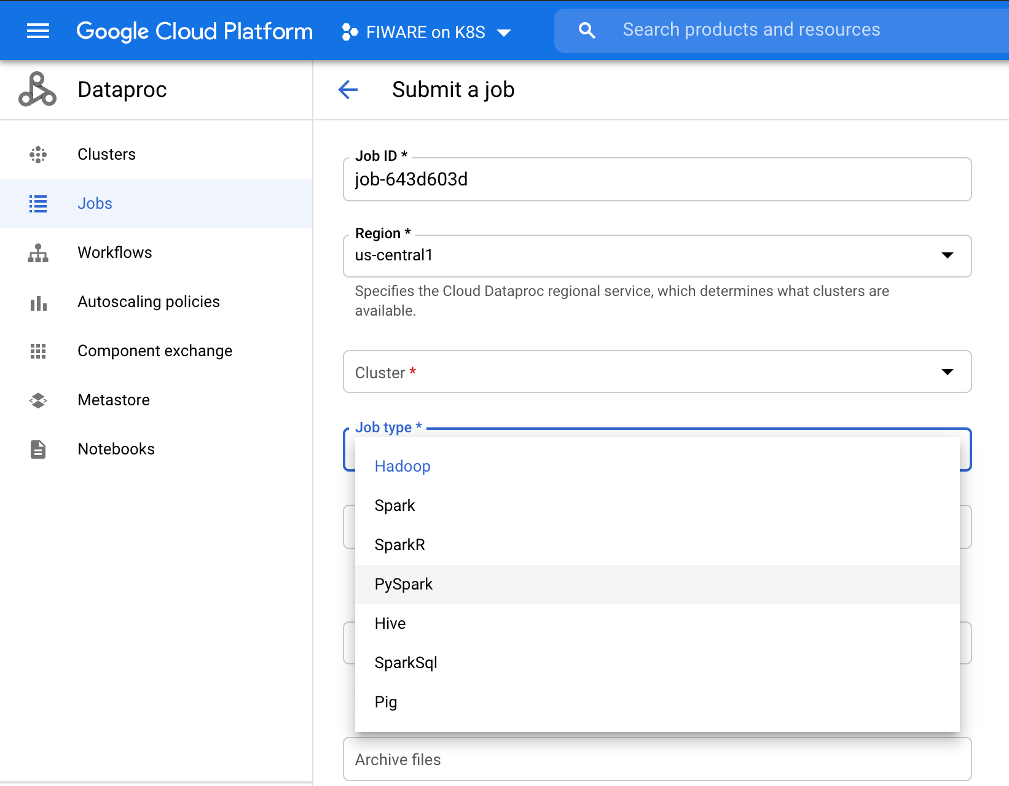
Submitting a Pyspark job using Dataproc GUI

Slide 48
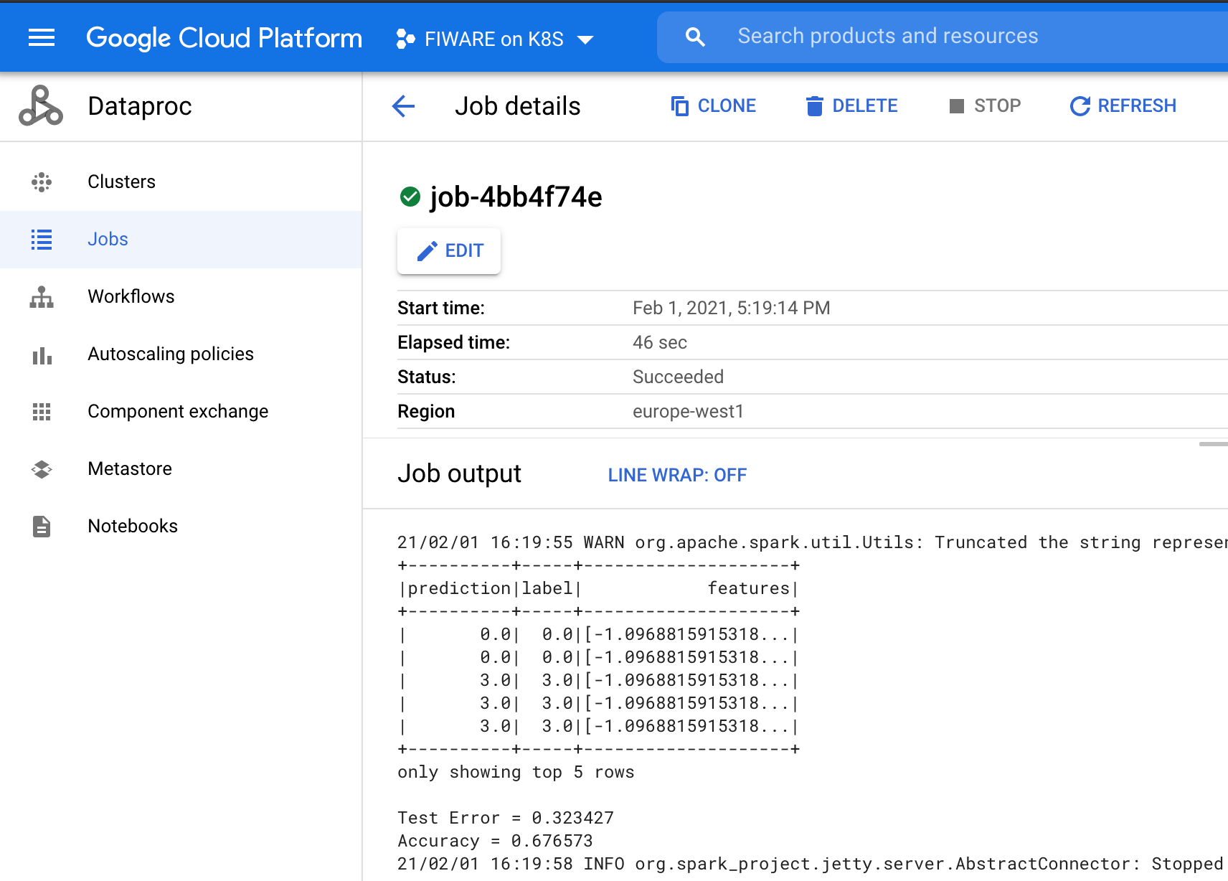
Submitting a Pyspark job to Dataproc cluster

